Slide 1
Changes in the Earth System
November 5, 2019

Slide 2
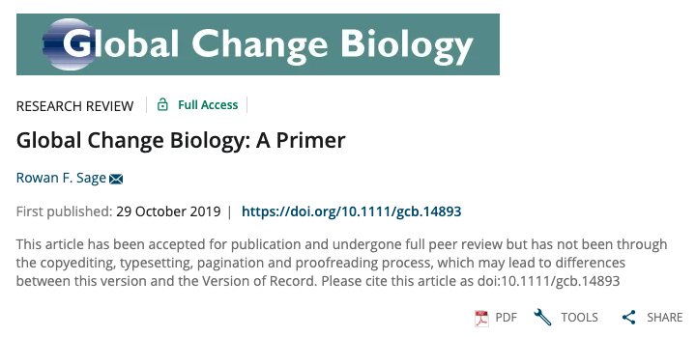

Slide 3
Have we entered a new epoch?

Slide 4
The Case for the Anthropocene
Proposed new epoch that has resulted primarily from human changes to the planet’s:
Elemental cycles
Climate
Biological diversity

Slide 5
The Case for the Anthropocene
Proposed new epoch that has resulted primarily from human changes to the planet’s:
Elemental cycles
Climate
Biological diversity

Slide 6
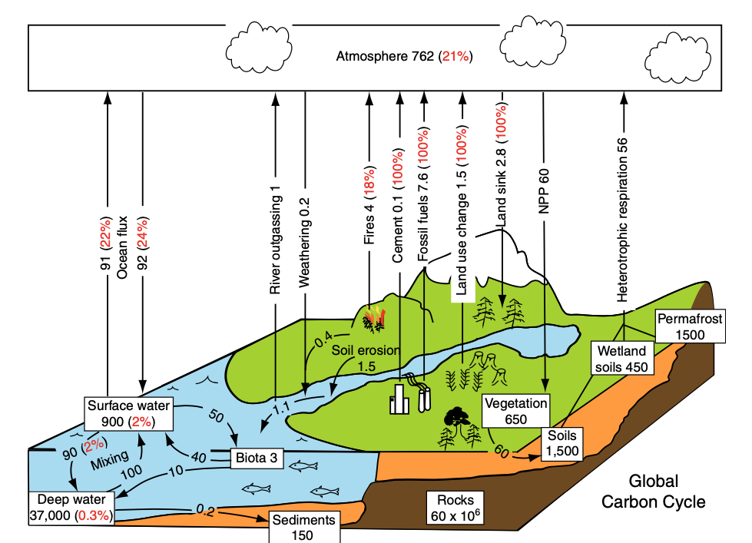
Units: 10¹⁵ g/yr
Chapin et al. (2011)

Slide 7
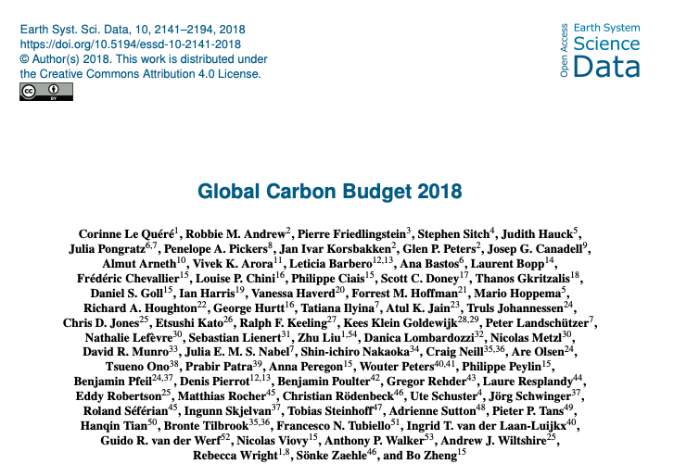
CO₂ is increasing in the atmosphere
Flux | Amount (Pg C/yr)
Fossil fuel burning | 9.4
LULCC | 1.5
Ocean uptake | 2.4
Land uptake | 3.2
Atmospheric growth | 4.7
Uncertainty | 0.5

Slide 8
CO₂ is increasing in the atmosphere
Flux | Amount (Pg C/yr)
Fossil fuel burning | 9.4
LULCC | 1.5
Ocean uptake | 2.4
Land uptake | 3.2
Atmospheric growth | 4.7
Uncertainty | 0.5
0.6 higher than book estimate (2007)

Slide 9
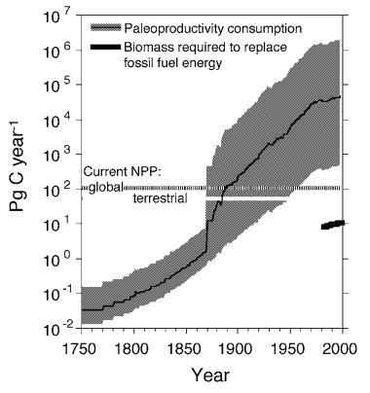
We are using more carbon than plants are putting back
Dukes (2003) “Burning buried sunshine”
Consumption if we switched to biofuels

Slide 10
Going up 5 ppm / year

Slide 11
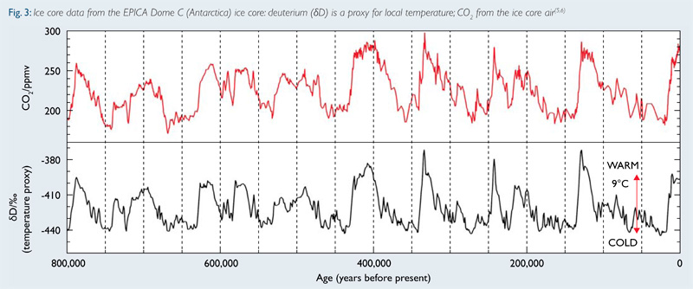
Historical rate of change: 0.002 ppm / year

Slide 13
Atmospheric methane (CH4) is also going up

Slide 15
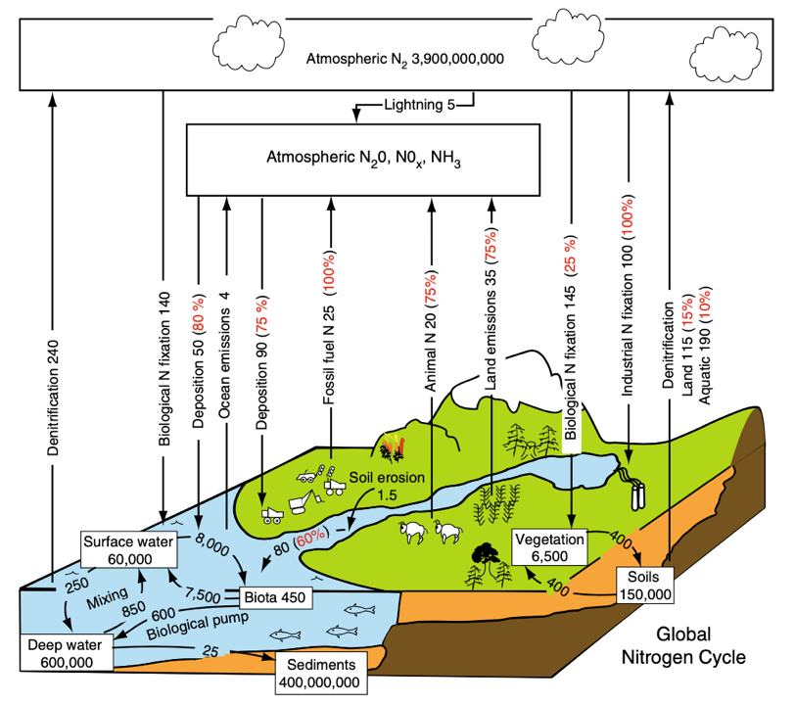
Units: 10¹² g/yr
Chapin et al. (2011)

Slide 16
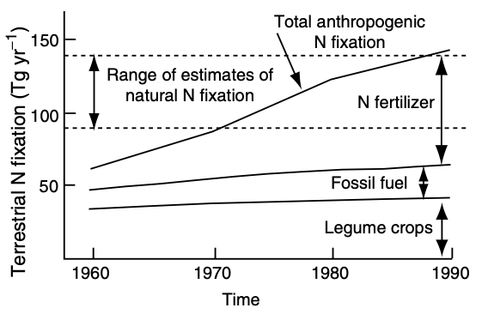
We’re pulling in a lot of atmospheric N…

Slide 17
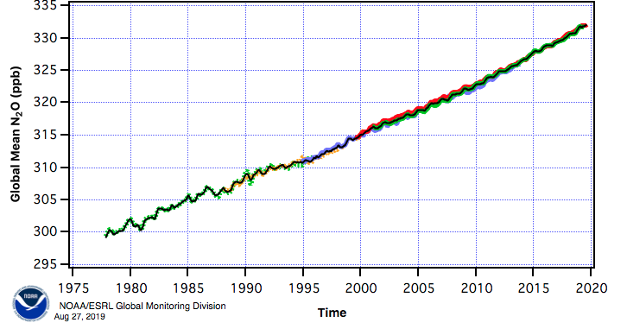
…while also pumping out a lot in new forms

Slide 19
How might US emissions differ from global emissions??

Slide 20
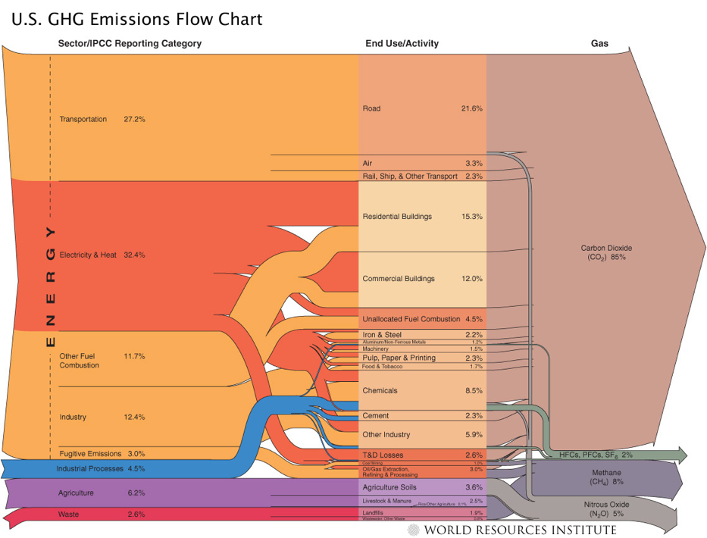

Slide 21
The Case for the Anthropocene
Proposed new epoch that has resulted primarily from human changes to the planet’s:
Elemental cycles
Climate
Biological diversity

Slide 22
Climate change is the result of human changes to elemental cycles

Slide 23
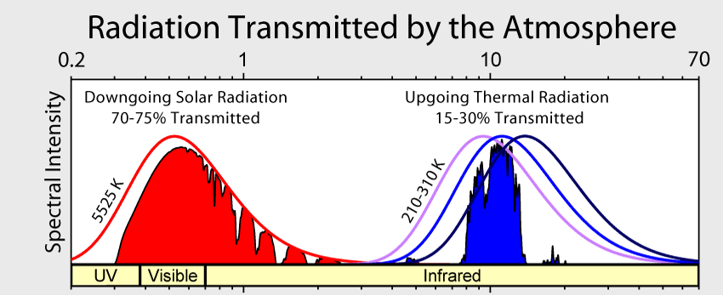

Slide 24
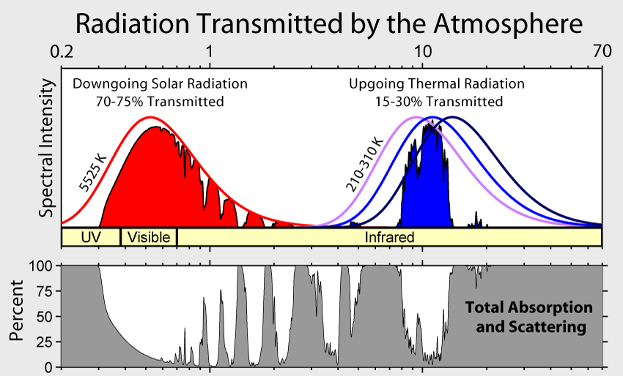

Slide 25
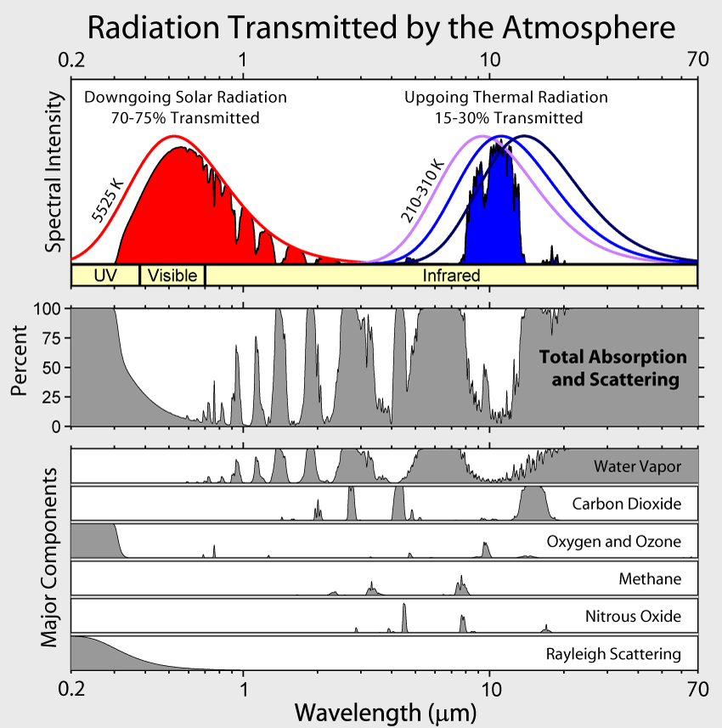

Slide 26
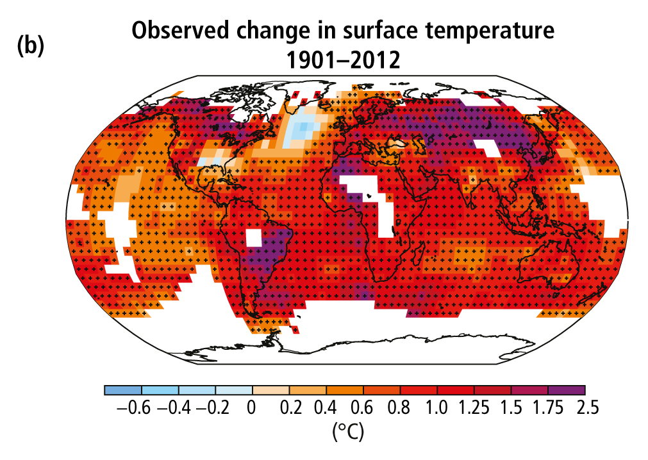
The climate is warming
Poles and land are warming the fastest
IPCC (2013)

Slide 27
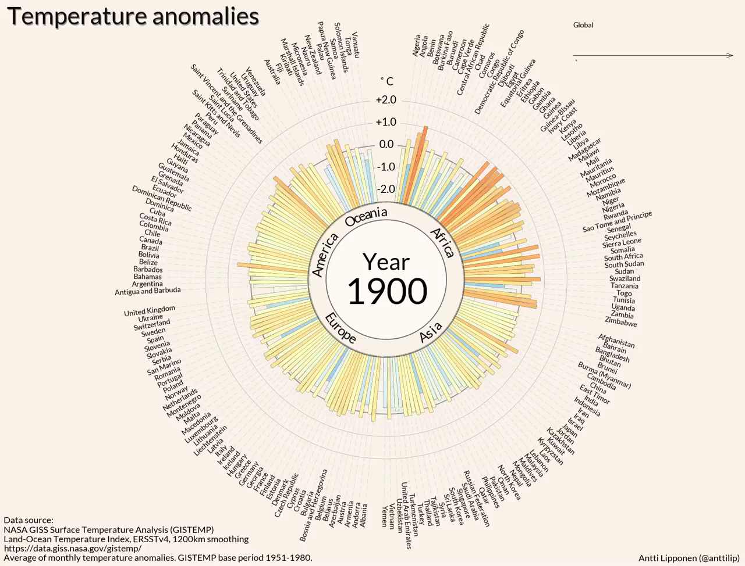

Slide 28
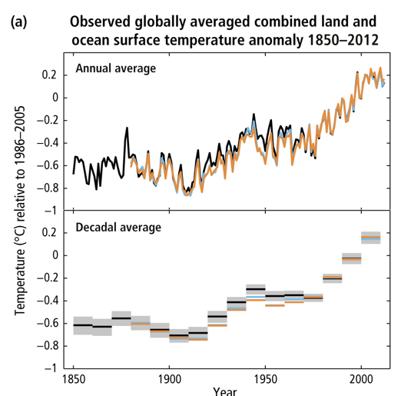
It’s warmer now than 150 years ago
The global mean temperature has increased ~1.5º F (0.8º C) over the past 150 years
IPCC (2013)

Slide 29
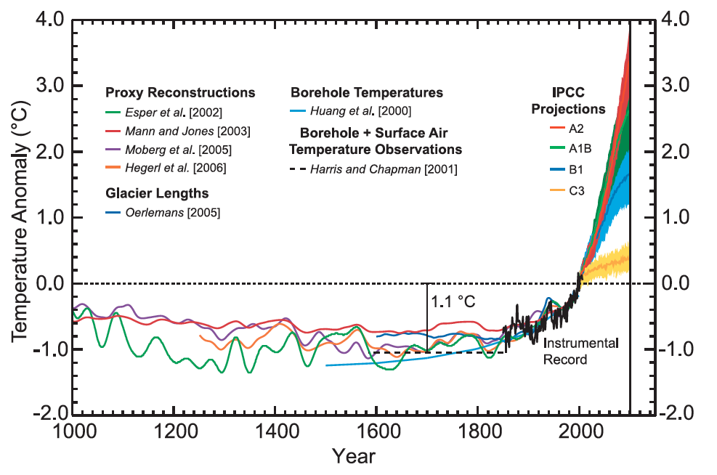
And warmest it’s been in the past 1000 years
Chapman & Davis (2010)

Slide 30
Other evidence: sea levels are rising

Slide 31
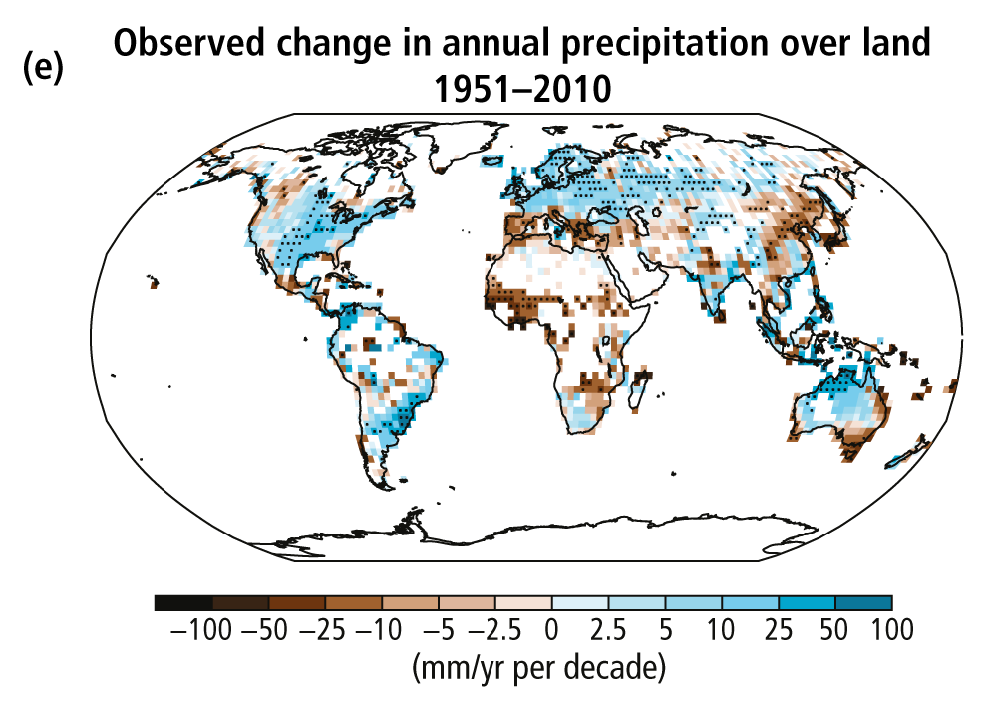
Global total precipitation is also changing
IPCC (2013)

Slide 32
As is precipitation variability
Increase in heaviest 1% precipitation (U. Michigan)

Slide 33
The Case for the Anthropocene
Proposed new epoch that has resulted primarily from human changes to the planet’s:
Elemental cycles
Climate
Biological diversity

Slide 34
Humans are threatening species of all types
IPBES

Slide 35
And the threat is increasing
IPBES

Slide 36
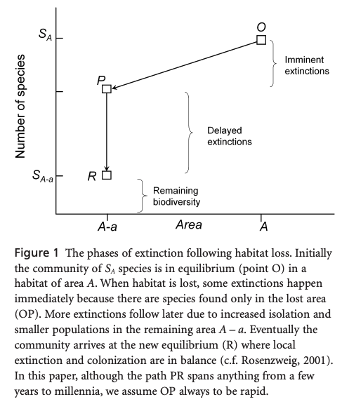
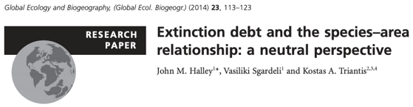
Species loss results from habitat loss

Slide 37
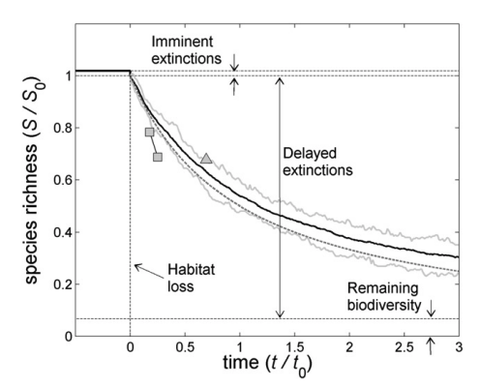
Species loss results from habitat loss

Slide 38
Invasive species are spreading…

Slide 39
Invasives are a threat everywhere
Early et al. (2016)

Slide 40
The Case for the Anthropocene
Proposed new epoch that has resulted primarily from human changes to the planet’s:
Elemental cycles
Climate
Biological diversity

Slide 41


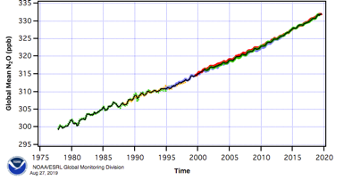
The Case for the Anthropocene
Do you buy it?

Slide 42
What would be the “golden spike”?

Slide 43
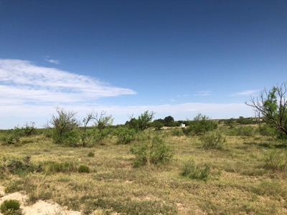
Class activity (in groups of four)
1. Pick an ecosystem service provided by West Texas ecosystems
Food
Fiber
Pollination
Water purity
Air purity
Energy
Climate regulation
Pest & disease control
Culture
History
Spiritual services
Recreation
Science Education
Therapy
2. Use a systems diagram to indicate how it will be impacted by global change

